Slide 1
ASP.NET MVC 5
07 May 18 | Start
26 Jun 18 | 1: 4-16
Appendix
Online

Slide 2
MVC 5
Ch | Date
1 | 00 May 18
2
3
4
5
6
7
8
9
10
11
12
13
Programming Microsoft ASP.NET MVC 5 2014

Slide 3
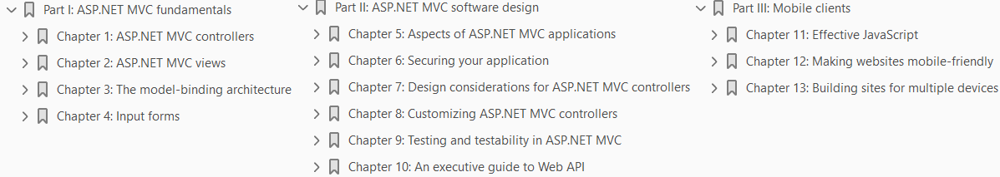

Slide 4

1
ASP.NET MVC Controllers

Slide 5
Intro
I think ASP.NET Web Forms started getting old the day that Ajax conquered the masses.
As some have said, Ajax has been the poisonous arrow shot in the heel of ASP.NET—another Achilles.
Ajax made getting more and more control over HTML and client-side code a true necessity.
Over time, this led to different architectures and made ASP.NET Web Forms a little less up to the task with each passing day.
Applied to the existing ASP.NET runtime, the MVC pattern produced a new framework—ASP.NET MVC—that aligns web development to the needs of developers today.
In ASP.NET MVC, each request results in the execution of an action—ultimately, a method on a specific class.
The results of executing the action are passed down to the view subsystem along with a view template.
The results and template are then used to build the final response for the browser.
Users don’t point the browser to a page, they just place a request.
Doesn’t that sound like a big change? Unlike Web Forms, ASP.NET MVC is made of various layers of code connected together but not intertwined and not forming a single monolithic block.
For this reason, it’s easy to replace any of these layers with custom components that enhance the maintainability as well as the testability of the solution.

Slide 6
Intro |
With ASP.NET MVC, you gain
total control over the markup and can apply styles and
inject script code at will using the JavaScript frameworks that you like most
Based on the same run-time environment as Web Forms, ASP.NET MVC
pushes a web-adapted implementation of the classic Model-View-Controller pattern and
makes developing web applications a significantly different experience

Slide 7
Agenda
In this chapter, you’ll discover the role and structure of the controller—the foundation of ASP.NET MVC applications—and how requests are routed to controllers.
Although you might decide to keep using Web Forms, for today’s web development, ASP.NET MVC is a much better choice.
You don’t need to invest a huge amount of time, but you need to understand exactly what’s going on and the philosophy behind MVC.
If you do that, any investment you make will pay you back sooner than you expect.

Slide 8
NOTE
This book is based on ASP.NET MVC 5.
This version of ASP.NET MVC is backward compatible with the previous versions.
This means that you can
install both versions side by side on the same computer and
play with the new version without affecting any existing MVC code that you might have already

Slide 9
Routing incoming requests
Originally, the entire ASP.NET platform was developed around the idea of serving requests for physical pages.
It turns out that most URLs used within an ASP.NET application are made of two parts:
the path to the physical webpage that contains the logic
some data stuffed in the query string to provide parameters
This approach has worked for a few years, and it still works today.
The ASP.NET run-time environment, however, doesn’t limit you to just calling into resources identified by a specific location and file.
By writing an ad hoc HTTP handler and binding it to a URL, you can use ASP.NET to execute code in response to a request regardless of the dependencies on physical files.
This is just one of the aspects that most distinguishes ASP.NET MVC from ASP.NET Web Forms.
Let’s briefly see how to simulate the ASP.NET MVC behavior with an HTTP handler.

Slide 10
Note
In software, the term URI (which stands for Uniform Resource Identifier) is used to refer to a resource by location or a name.
When the URI identifies the resource by location, it’s called a URL, or Uniform Resource Locator.
When the URI identifies a resource by name, it becomes a URN, or Uniform Resource Name.
In this regard, ASP.NET MVC is designed to deal with more generic URIs, whereas ASP.NET Web Forms was designed to deal with location-aware physical resources.

Slide 11
Simulating the ASP.NET MVC runtime
Let’s build a simple ASP.NET Web Forms application and use HTTP handlers to figure out the internal mechanics of ASP.NET MVC applications.
You can start from the basic ASP.NET Web Forms application you get from your Microsoft Visual Studio project manager.

Slide 12
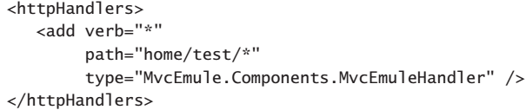
Defining the syntax of recognized URLs
In a world in which requested URLs don’t necessarily match up with physical files on the web server, the first step to take is listing which URLs are meaningful for the application.
To avoid being too specific, let’s assume that you support only a few fixed URLs, each mapped to an HTTP handler component.
The following code snippet shows the changes required to be made to the default web.config file:
Whenever the application receives a request that matches the specified URL, it will pass it on to the specified handler.

Slide 13
Defining the behavior of the HTTP handler
In ASP.NET, an HTTP handler is a component that implements the IHttpHandler interface.
The interface is simple and consists of two members, as shown here: Code 1-1.
Most of the time, an HTTP handler has a hardcoded behavior influenced only by some input data passed via the query string.
However, nothing prevents us from using the handler as an abstract factory for adding one more level of indirection.
The handler, in fact, can use information from the request to determine an external component to call to actually serve the request.
In this way, a single HTTP handler can serve a variety of requests and just dispatch the call among a few more specialized components.
The HTTP handler could parse out the URL in tokens and use that information to identify
the class and
the method to invoke
Here’s an example of how it could work: Code 1-2.

Slide 14
Defining the behavior of the HTTP handler |
The preceding code assumes that
the first token in the URL after the server name contains the key information to identify the specialized component that will serve the request
The second token refers to the name of the method to call on this component
Finally, the third token indicates a parameter to pass

Slide 15
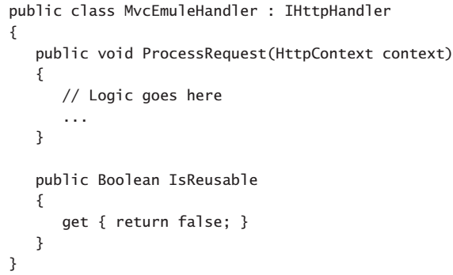
Code 1-1

Slide 16
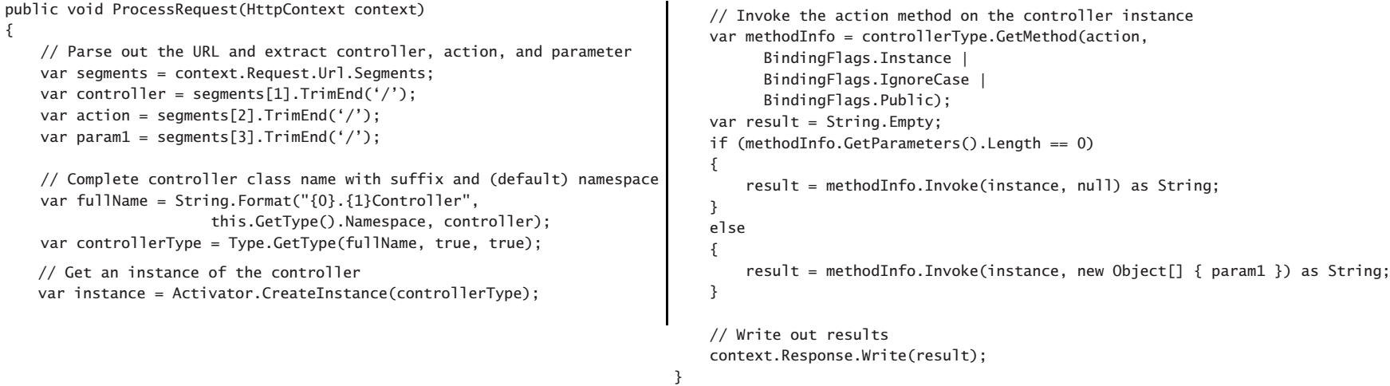
Code 1-2

Slide 17
Invoking the HTTP handler
Given a URL such as home/test/*, it turns out that
home identifies the class
test identifies the methods, and
whatever trails is the parameter
The name of the class is further worked out and extended to include
a namespace and
a suffix
According to the example, the final class name is MvcEmule.Components.HomeController.
This class is expected to be available to the application.
The class is also expected to expose a method named Test, as shown here: Code 1-3.
Figure 1-1 shows the effect of invoking a page-agnostic URL in an ASP.NET Web Forms application.
This simple example demonstrates the basic mechanics used by ASP.NET MVC.
The specialized component that serves a request is the controller.
The controller is a class with just methods and no state.

Slide 18
Invoking the HTTP handler |
A unique system-level HTTP handler takes care of dispatching incoming requests to a specific controller class so that the instance of the class executes a given action method and produces a response.
What about the scheme of URLs? In this example, you just use a hardcoded URL.
In ASP.NET MVC, you have a very flexible syntax that you can use to express those URLs that the application recognizes.
In ASP.NET MVC, you have a very flexible syntax that you can use to express those URLs that the application recognizes.
In addition, a new system component in the run-time pipeline
intercepts requests
processes the URL
triggers the ASP.NET MVC HTTP handler
This component is the URL Routing HTTP module.

Slide 19
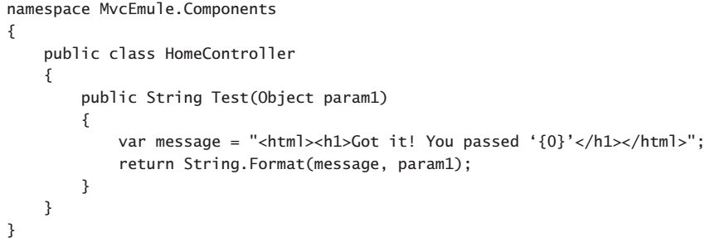
Code 1-3

Slide 20
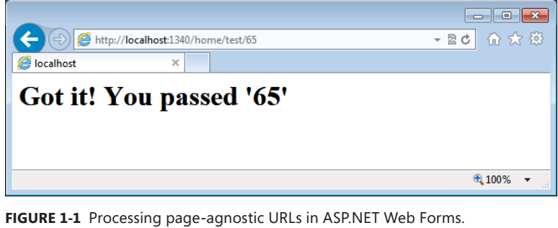
Figure 1-1

Slide 21
The URL routing HTTP module
The URL routing HTTP module processes incoming requests by looking at the URLs and dispatching them to the most appropriate executor.
The URL routing HTTP module supersedes the URL rewriting feature of older versions of ASP.NET.
At its core, URL rewriting consists of
hooking up a request
parsing the original URL
instructing the HTTP run-time environment to serve a “possibly related but different” URL

Slide 22
Superseding URL rewriting
URL rewriting comes into play if you need to make tradeoffs between needing human-readable and search engine optimization (SEO)-friendly URLs and needing to programmatically deal with tons of URLs.
For example, consider the following URL:
The news.aspx page incorporates any logic required to retrieve, format, and display any given news.
The ID for the specific news to retrieve is provided via a parameter on the query string.
As a developer, implementing the page couldn’t be easier;
you get the query string parameter
run the query
create the HTML
As a user or for a search engine, by simply looking at the URL you can’t really understand the intent of the page, and you aren’t likely to remember the address easily enough to pass it around.

Slide 23
Application routes
By design, an ASP.NET MVC application is not forced to depend on physical pages. In ASP.NET MVC, users place requests for acting on resources. The framework, however, doesn’t mandate the syntax for describing resources and actions. I’m aware that the expression “acting on resources” will likely make you think of Representational State Transfer (REST). And, of course, you will not be too far off the mark in thinking so.
(Page 9).

Slide 25
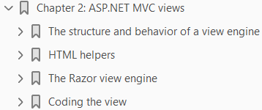
2
ASP.NET MVC Views

Slide 26
Intro
In ASP.NET MVC, any request is resolved in terms of an action being executed on some controller.
Even for a newcomer, this point is relatively easy to understand and figure out.
But, there’s another aspect of the request that the newcomer often has difficulty grasping—the generation of the HTML for the browser.
In ASP.NET Web Forms, you don’t even think of an action—you think of a page, and a page incorporates both logic and view.
In classic ASP.NET, you start with, say, a register.aspx page that the user reaches following a link.
The page unfolds its user interface, which ends with a submit button.
The button originates a POST to the same page that takes care of posted data, modifies the state of the application as appropriate, and prepares the expected thank-you screen.
The entire process is rooted in the page resource.
However, in ASP.NET MVC, you set up a Register action on some controller class.
When the action is invoked over a GET command, it results in the display of the user interface for the data entry.
When invoked over a POST, the action performs the desired server-side tasks and then manages to serve back the thank-you screen.

Slide 27
Intro |
The entire workflow is similar to what you have in a nonweb scenario
In ASP.NET MVC, you just deal with two main flavors of components.
One is the controller, which is in charge of executing the request and producing raw results in return for raw input.
The other is the view engine, which is in charge of generating any expected HTML response based on the results calculated by the controller.
In this chapter, I’ll first briefly discuss the internal architecture of the view engine and then move to more practical considerations on how you feed an engine with view templates and data.

Slide 28
Note
As is demonstrated in Chapter 1, “ASP.NET MVC controllers,” a controller action doesn’t necessarily produce some HTML.
You can look upon an ASP.NET MVC application as a collection of components with the ability to serve various responses, including
HTML
JavaScript
JavaScript Object Notation (JSON)
plain text
In this chapter, I’ll restrict the discussion to considering the subsystem responsible for the production of HTML.
Later in the book, I discuss other types of responses in more detail.

Slide 29
The structure and behavior of a view engine
The view engine is the component that physically builds the HTML output for the browser.
The view engine engages for each request that returns HTML, and it prepares its output by mixing together a template for the view and any data the controller passes in.
The template is expressed in an engine specific markup language; the data is passed packaged in dictionaries or in strongly typed objects.
Figure 2-1 shows the overall picture of how a view engine and controller work together.

Slide 30
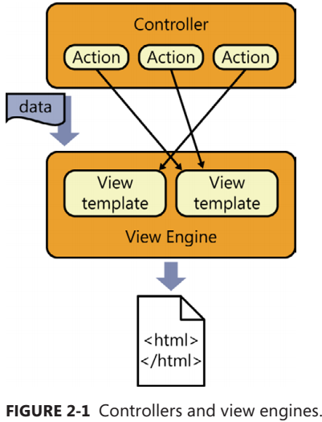
Figure 2-1

Slide 31
The mechanics of a view engine
In ASP.NET MVC, a view engine is merely a class that implements a fixed interface—the IViewEngine interface.
Each application can have one or more view engines.
In ASP.NET MVC 5, each application comes by default with two view engines.
Let’s find out more.

Slide 32
Detecting registered view engines
Until ASP.NET MVC 4, when you first created an ASP.NET MVC application, the Microsoft Visual Studio project wizard asked you to pick your favorite view engine—whether
ASPX
Razor
Figure 2-2 shows the specific dialog box as it appears when ASP.NET MVC 5 is installed in Visual Studio 2013.
As you can see, there’s no choice between ASPX and Razor, and all view files are automatically created by using the Razor markup language.
In spite of appearances, the choice you make here has a limited impact on the application.
Your choice, in fact, influences only the content of the project files the wizard will create for you.
By default, any ASP.NET MVC 5 application will always load two view engines:
Razor
ASPX
The ViewEngines class is the system repository that tracks the currently installed engines.
The class is simple and exposes only a static collection member named Engines.
The static member is initialized with the two default engines. Here’s an excerpt from the class: Code 2-1.

Slide 33
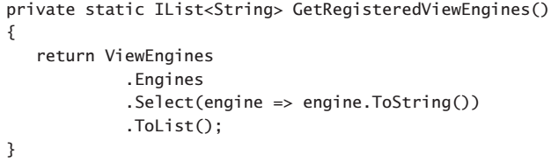
Detecting registered view engines |
In case you’re interested in using ViewEngines.Engines to detect the installed engines programmatically, here’s how to do it:
The most likely scenario in which you might encounter ViewEngines.Engines is when you need to add a new view engine or unload an existing one.
You do this in the application startup, more precisely, in the Application_Start event in global.asax.

Slide 34
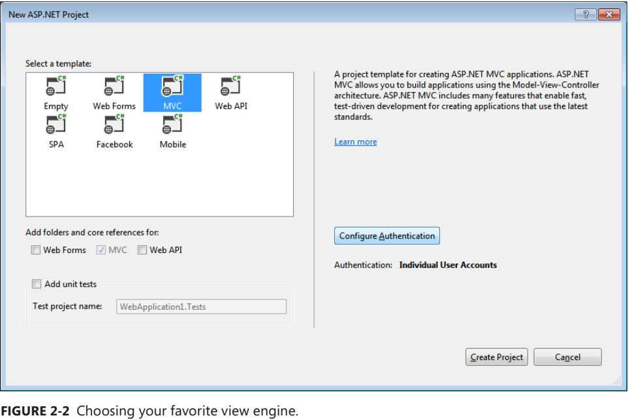
Figure 2-2

Slide 35
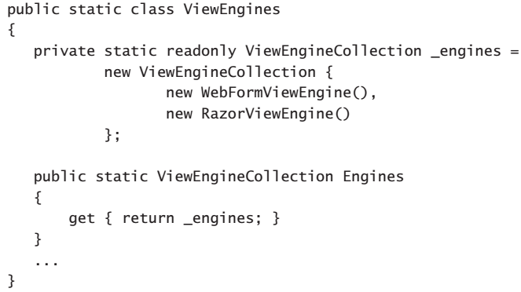
Code 2-1

Slide 36
Anatomy of a view engine
A view engine is a class that implements the IViewEngine interface.
The contract of the interface says it’s all about the services the engine is expected to provide:
the engine is responsible for retrieving a (partial) view object on behalf of the ASP.NET MVC infrastructure.
A view object represents the container for any information that is needed to build a real HTML response in ASP.NET MVC.
Here are the interface members: Code 2-2.
Table 2-1 describes the behavior of the methods in the IViewEngine interface.
Both FindPartialView and FindView return a ViewEngineResult object, which represents the results of locating a template for the view around the server directory tree and instantiating it.
Here’s the class signature: Code 2-3.
The ViewEngineResult type just aggregates three elements:
the view object
the view engine object used to create it
the list of locations searched to find the template of the view

Slide 37
Anatomy of a view engine |
The content of the SearchedLocations property depends on the structure and behavior of the selected view engine.
The ReleaseView method is intended to dispose of any references that the view object has in use.

Slide 38
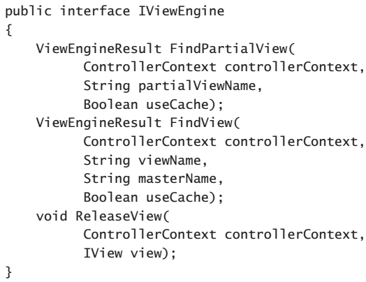
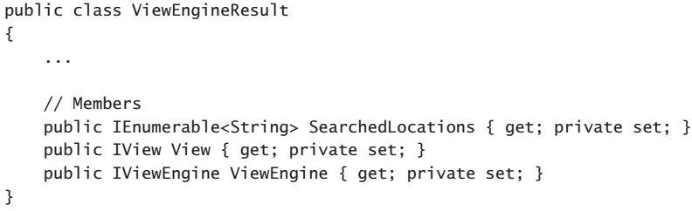
Code 2-2 || 2-3

Slide 39
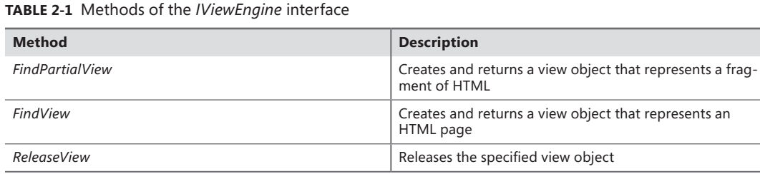
Table 2-1

Slide 40
Who calls the view engine?
Although Figure 2-1 seems to show direct contact between controllers and view engines, the two components never communicate directly.
Instead, the activity of both controllers and view engines is coordinated by an external manager object:
the action invoker
The action invoker is triggered directly by the HTTP handler in charge of the request.
The action invoker does two key things.
First, it executes the controller’s method and saves the action result.
Next, it processes the action result.
Figure 2-3 presents a sequence diagram.

Slide 41
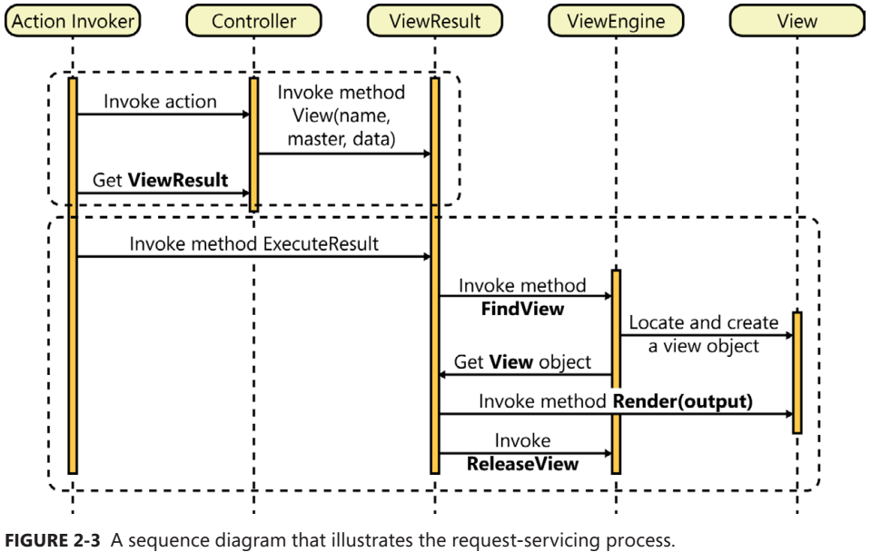
Figure 2-3

Slide 42
Example
Let’s consider the typical code of a controller method as you saw it in Chapter 1 – Code 2-4.
The View method on the controller class packs a few pieces of data together in a single container:
the ViewResult class.
Information includes the name of the view template that the controller has selected as the next view to show to the user.
An optional piece of data that goes into ViewResult is the name of the master view.
Finally, the ViewResult container also incorporates the calculated data that will be displayed in the view.
When the View method gets no parameters, as in the code snippet shown earlier, default values are provided.
An instance of ViewResult object is delivered back to the action invoker.
Next, the action invoker invokes the ExecuteResult method on the ViewResult object.
The method goes through the list of registered view engines to find one that can match the specified view and master view names.
If no such view engine is found, an exception is thrown.
Otherwise, the selected view engine is asked to create a view object based on the information provided.

Slide 43
Example |
Subsequently, the ViewResult object orders the view to render its content out to the provided stream—the actual response stream.
Finally, the ViewResult object instructs the view engine to release the view.

Slide 44
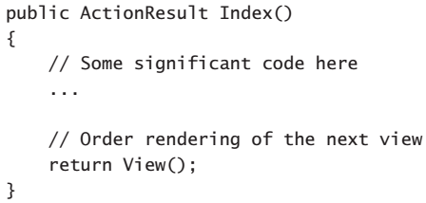
Code 2-4

Slide 45
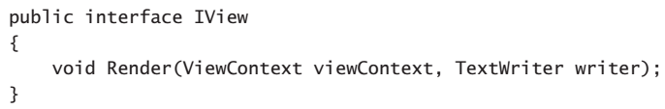
The view object
The view object is an instance of a class that implements the IView interface.
The only purpose of a view object is for writing some HTML response to a text writer.
Each view is identified by name.
The name of the view is also associated with some physical file that defines the HTML layout to render.
Resolving the association between the view name and actual HTML layout is the responsibility of the view engine.
The name of the view is one of the parameters that the View method on the controller action is supposed to provide.
If no such parameter is explicitly defined by the programmer, the system assumes by convention that the name of the view is the same as the action name. (As is demonstrated in Chapter 1, the action name doesn’t necessarily match the method name.)
The IView interface is shown here:

Slide 46
The view object |
Under the hood, a view object is a wrapper around an object that describes a visual layout devoid of data.
Rendering the view means populating the layout with data and rendering it as HTML to some stream.
Of the two default view engines in ASP.NET MVC, one—the ASPX view engine—just uses a derivative of the ASP.NET Page class to represent the visual layout.
The other view engine—the Razor engine—is based on a different class designed around the same core idea.
The Razor engine uses the WebMatrix counterpart of an ASP.NET Page class.

Slide 47
Definition of the view template
In ASP.NET MVC, everything being displayed to the user results from a view and is described in terms of a template file.
The graphical layout is then transformed into HTML and styled via one or more cascading style sheet (CSS) files.
The way in which the template file is written, however, depends on the view engine.
Each view engine has its own markup language to define the template, and its own set of rules to resolve a view name into a template file.

Slide 48
Resolving the template
At the end of its job, the controller figures out the name of the next view to render to the user. However, the name of the view must be translated into some good HTML markup. This takes a couple more steps. First, the system needs to identify which view engine (if any) can successfully process the request for the view. Second, the view name must be matched to an HTML layout and a view object must be successfully created from there.
(Page 39).

Slide 49
Default conventions and folders
Both the ASPX and Razor view engines use the same core conventions to resolve view names. Both match view names to file names, and both expect to find those files in the same set of predefined folders. The only difference between ASPX and Razor is the extension of the files that contain the view layout.
(Page 39).

Slide 50
The template for the view
As mentioned, a view is nothing more than a template for the resulting HTML content. The following is valid content for a view template file to find in some Views subfolder. The view template targets the ASPX view engine.
(Page 41).

Slide 51
The master view
Just like in ASP.NET Web Forms, you need to decide whether you want to write the view template entirely from scratch or inherit some common markup from a master view. If you choose the latter option, you define the master template with respect to the syntax and constraints set by the view engine.
(Page 42).

Slide 55
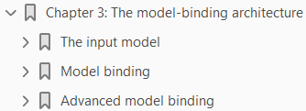
3

Slide 56
Intro

Slide 57
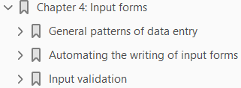
4

Slide 58
Intro

Slide 59
5

Slide 60
Intro

Slide 61
6

Slide 62
Intro

Slide 63
7

Slide 64
Intro

Slide 65
8

Slide 66
Intro

Slide 67
9

Slide 68
Intro

Slide 69
10

Slide 70
Intro

